Slide 1

SAP Cloud Platform Integration Training
Day 1: SOAP To SOAP Scenario
September 2019

Slide 2
Business Scenario
To obtain Calculator service in real time. Consume a synchronous webservice using SAP CPI(Cloud Platform Integration) and return the conversion rate (response from webservice) back to the sender system.
Attached is the WSDL used in the scenario.

Slide 3
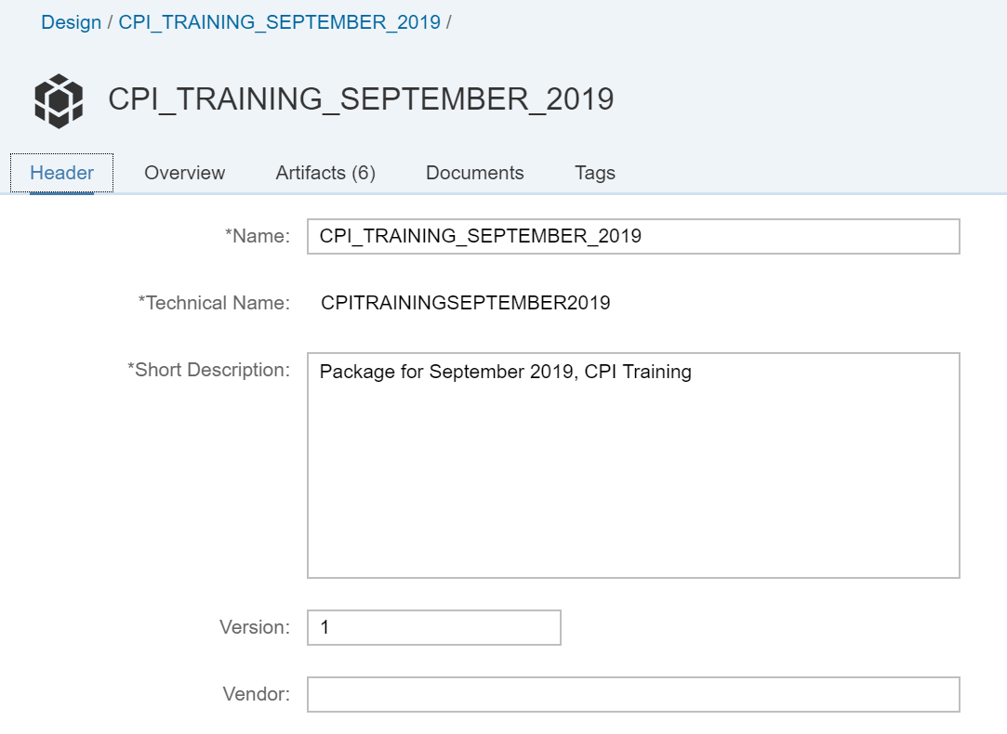
Creating End to End SOAP Scenario using Web UI
Click on Design Icon . Under the Design , Click on Create a Package . Enter the mentioned values and save them

Slide 4
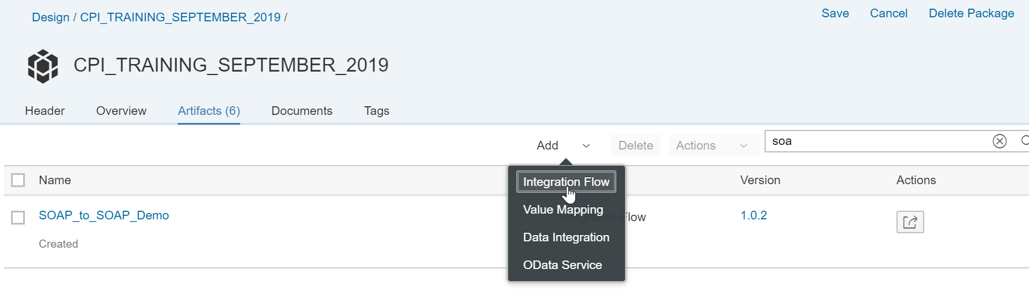
Creating End to End SOAP Scenario using Web UI (Cont’d…)
Under the package,
Click on Artifact to include objects into your package.
Add Option will help us to create Integration IFlow.

Slide 5
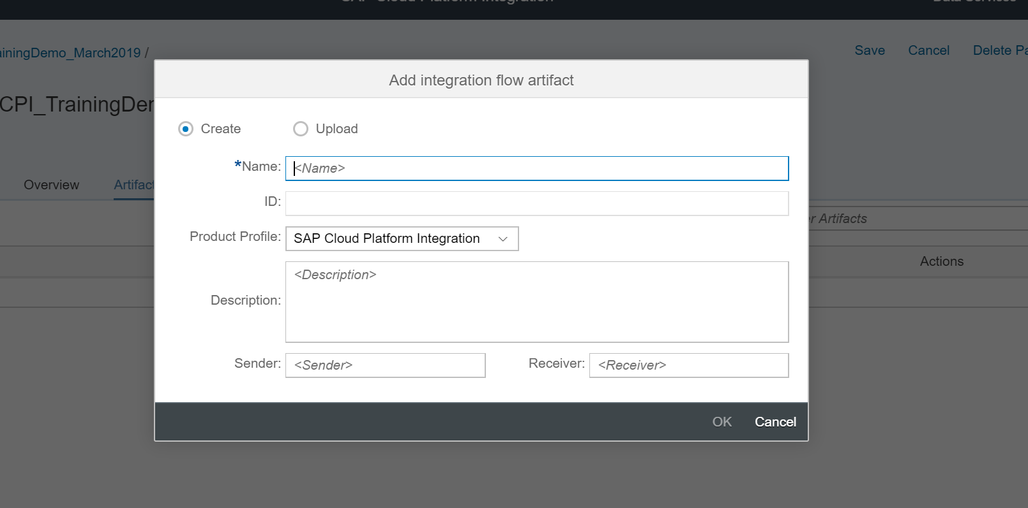
Creating End to End SOAP Scenario using Web UI (Cont’d…)
Create IFlow. Enter name , Description , Sender & Receiver and Click OK.

Slide 6
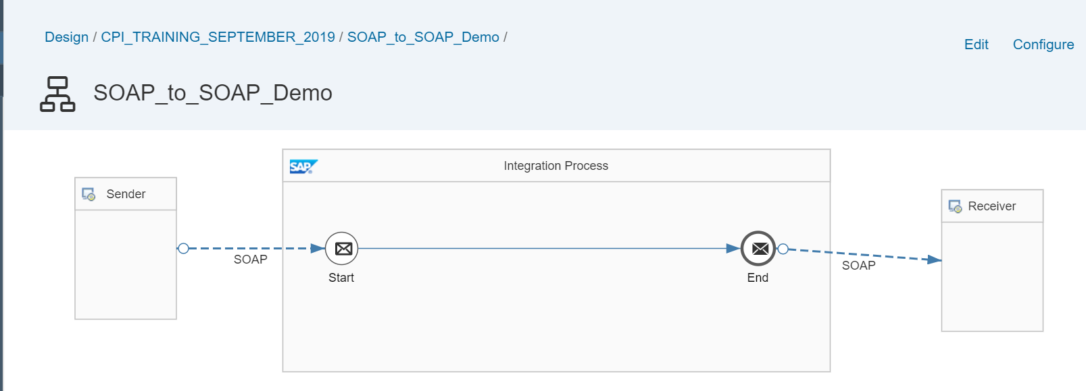
Creating End to End SOAP Scenario using Web UI (Cont’d…)
Basic Iflow will be created. Click on Edit to Add the Sender & Receiver channels.

Slide 7
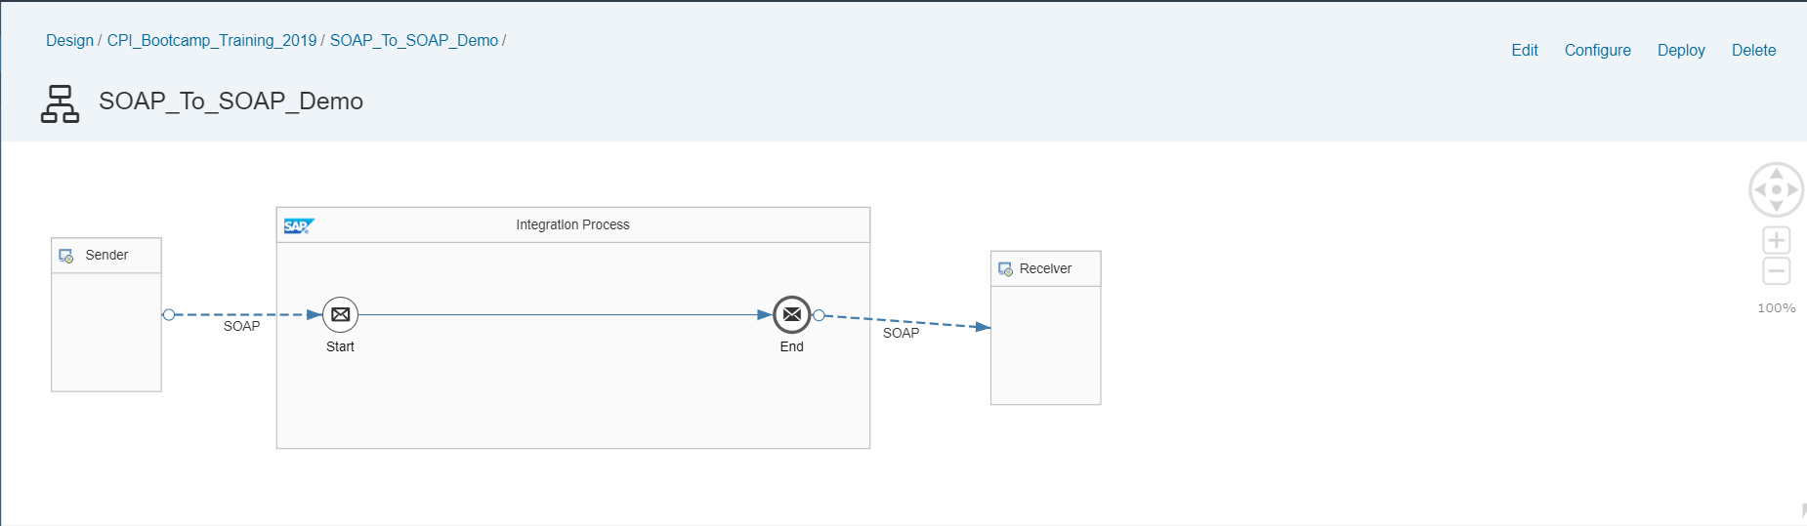
Creating End to End SOAP Scenario using Web UI (Cont’d…)
Click on the Sender to Add the Sender adapter using Arrow. Similarly Create Receiver channel.

Slide 8
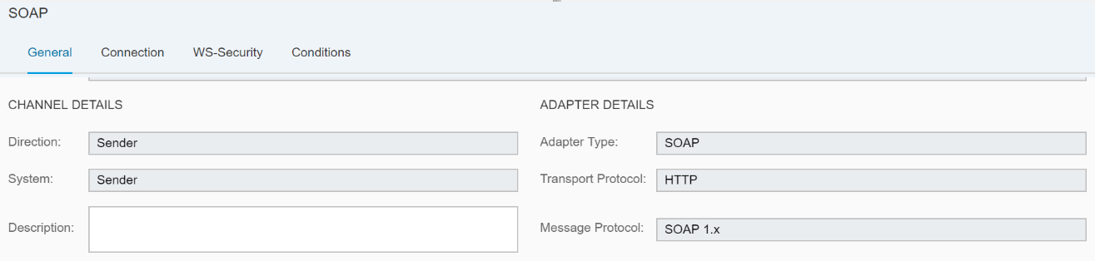
Creating End to End SOAP Scenario using Web UI (Cont’d…)
Double click on the Sender SOAP channel . Under the Tab General , Choose Transport Protocol as HTTP and Message Protocol as SOAP 1.x.

Slide 9
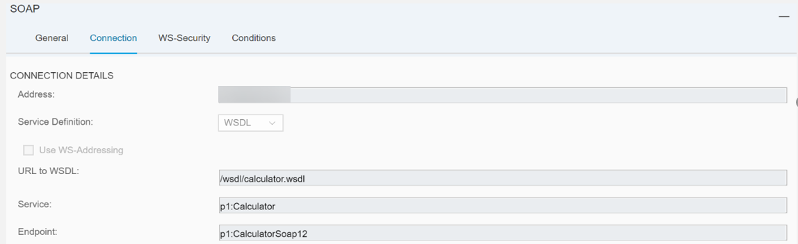
Creating End to End SOAP Scenario using Web UI (Cont’d…)
Under the connection Tab , Mention the Following details
Address: URL used to trigger the SOAP Service (Note: This address should be unique across the Tenant)
Service Definition: Manual/WSDL
URL To WSDL: Upload the WSDL from the File system.
Service & End point values will be used /filled directly from the WSDL

Slide 10
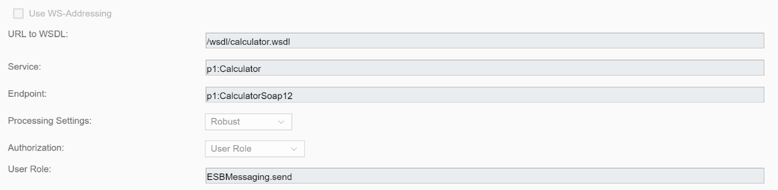
Creating End to End SOAP Scenario using Web UI (Cont’d…)
Under the connection Tab ,
Maintain Authorization: User Role/Certificate.
Robust is used for synchronous communication
User should have *ESBMessaging.send role to perform this operation.
*This is required while triggering the service from the source provided , we will using CPI Credentials or Certificates to authenticate for handshake.

Slide 11
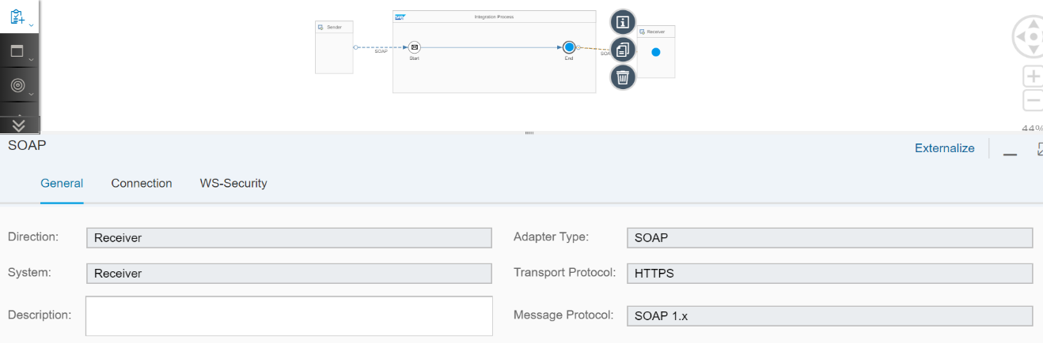
Creating End to End SOAP Scenario using Web UI (Cont’d…)
Double click on the Receiver SOAP channel. Under the Tab General , Choose Transport Protocol as HTTPS and Message Protocol as SOAP 1.x.

Slide 12
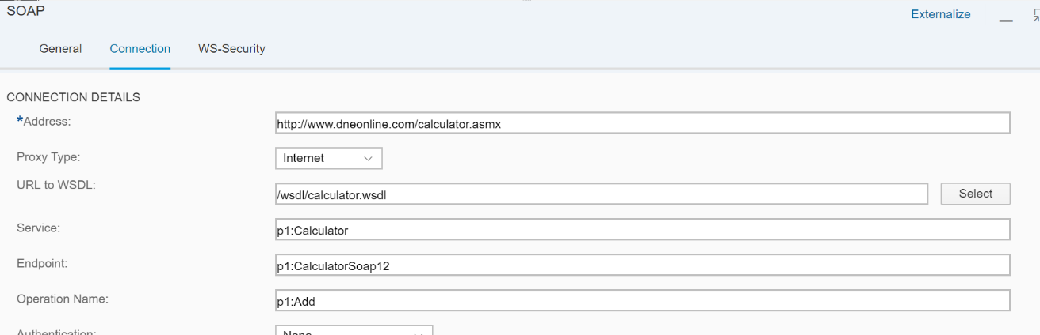
Creating End to End SOAP Scenario using Web UI (Cont’d…)
Service and endpoint will get populated automatically. Choose Processing Settings as ‘Robust’ to receive a response for the message sent. Robust is used for synchronous communication. Give the below details in the receiver channel. Address: http://www.dneonline.com/calculator.asmx

Slide 13
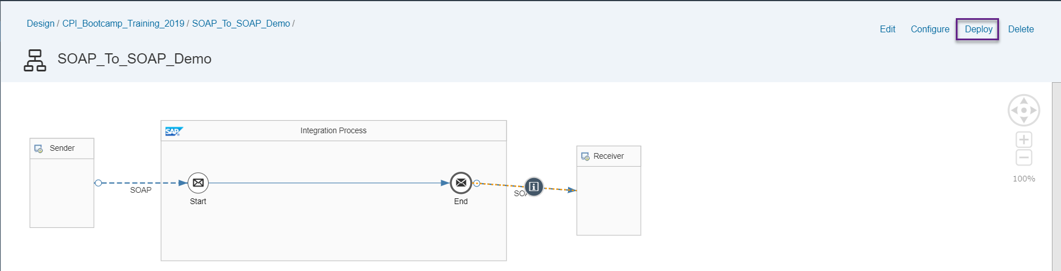
Deployment
On the Right Top corner, Click on the Deploy to activate your scenario.

Slide 14
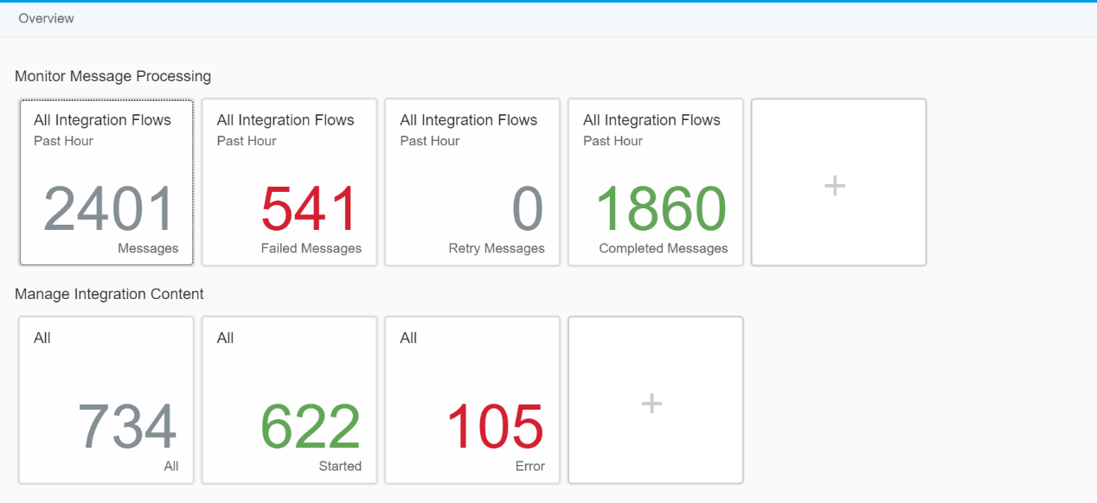
Overview
Click on the Operations View On the Home page . It directs you to the Overview Work bench .
This workbench is used for Monitoring all your Integration content.
Once deployed, you can view your Iflow Scenario status as “Started” under the Manage Integration Content.

Slide 15
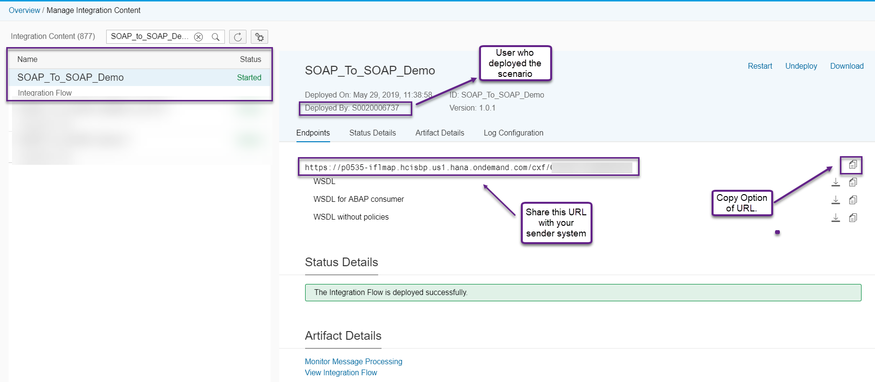
Manage Integration content
Choose your scenario under the Integration content . You can see the End point URL for your Iflow Scenario

Slide 16
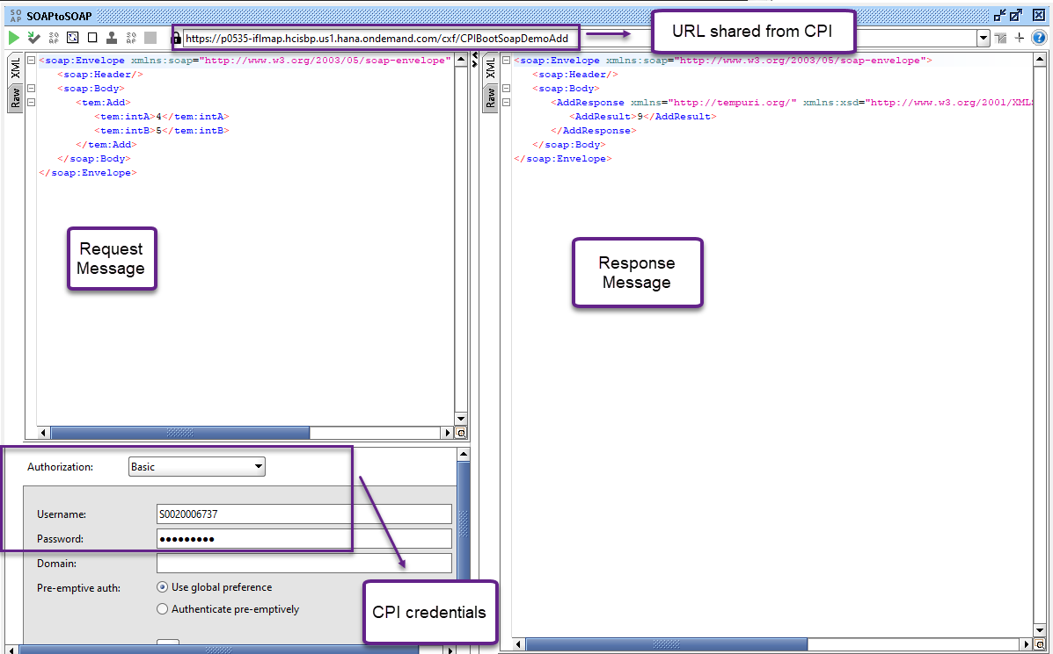
Testing
Open SOAP UI and create a New SOAP Project.
Browse the WSDL file from the local disk.
Use the End point URL to trigger the service.
Enter the SAP CPI Login credentials under Authorization “ Basic “
Execute the SOAP Request & Check the Response.

Slide 17
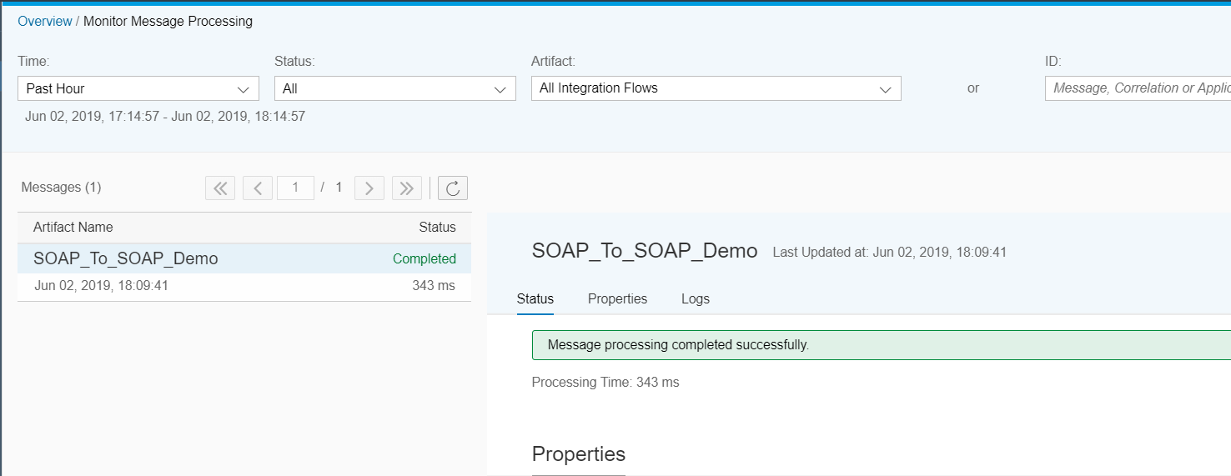
Monitoring Messages
You can monitor your messages by going to Monitor message processing and checking logs against your iflow Name.

Slide 18
About Deloitte
Deloitte refers to one or more of Deloitte Touche Tohmatsu Limited, a UK private company limited by guarantee (“DTTL”), its network of member firms, and their related entities. DTTL and each of its member firms are legally separate and independent entities. DTTL (also referred to as “Deloitte Global”) does not provide services to clients. In the United States, Deloitte refers to one or more of the US member firms of DTTL, their related entities that operate using the “Deloitte” name in the United States and their respective affiliates. Certain services may not be available to attest clients under the rules and regulations of public accounting. Please see www.deloitte.com/about to learn more about our global network of member firms.
Copyright © 2019 Deloitte Development LLC. All rights reserved.

